Slide 1
Social Inequality
MS.SHAHTAJ SHAKIR
FAST UNIVERSITY NUCES

Slide 2
LEARNING OUTCOMES
1.Social stratification
2. Global stratification: Class, Caste (racial) , Slavery and Estate
3.Understanding Social Mobility and its types
4. Sociological perspectives on stratification

Slide 3
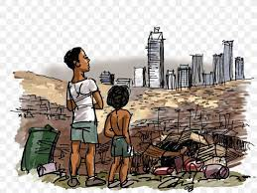
Social inequality
1.Different access to resources , wealth overall.
2. Different access to education, income, judicial treatment.
Notes:
https://ecampusontario.pressbooks.pub/sociologymohawkcollege/chapter/chapter-9-social-inequality-in-canada/

Slide 4

Social stratification
Sociologists use the term social stratification to describe the system of social standing.
Social stratification is a system in which groups of people are divided into layers according to their relative property, power, and prestige.
Notes:
https://openstax.org/books/introduction-sociology-3e/pages/9-1-what-is-social-stratification

Slide 5
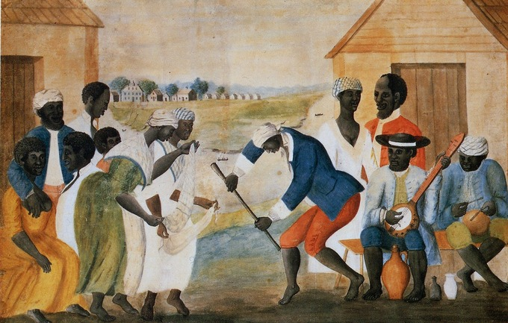
four major systems of social stratification:
Four major systems of social stratification:
1. Slavery
2.Caste
3.Estate
4.Class.

Slide 6
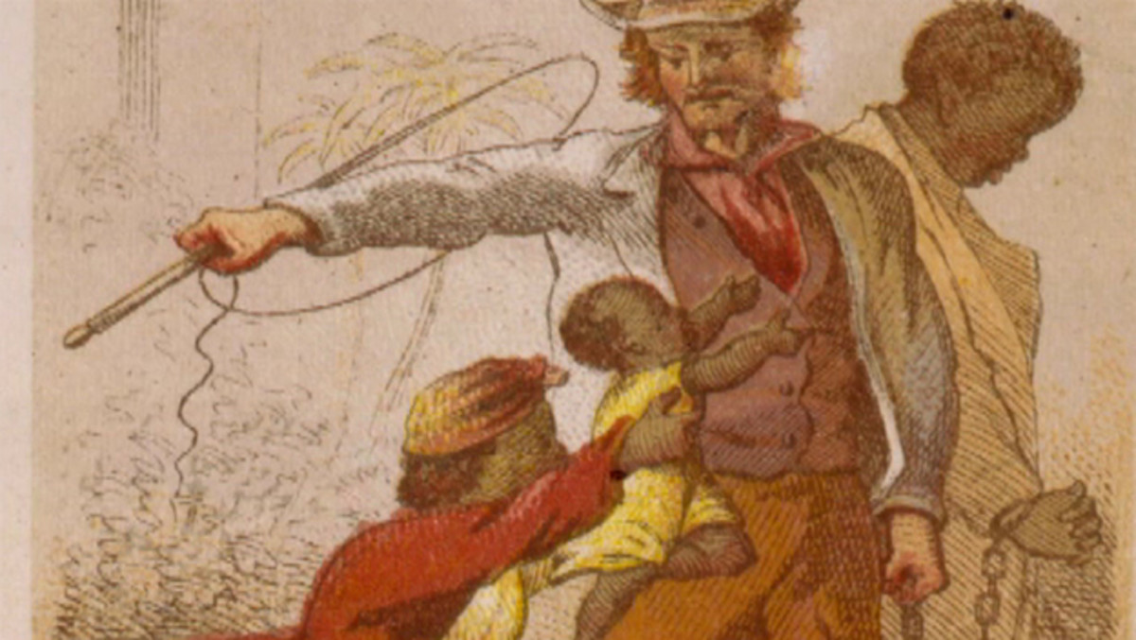
1. sLavery
Slavery, whose essential characteristic is that some individuals own other people, has been common throughout history.

Slide 7
Causes of slavery
Debt: The first was debt. In some societies, creditors would enslave people who could not pay their debts.
Crime: The second was crime. Instead of being killed, a murderer or thief might be enslaved by the victim’s family as compensation for their loss.
War: The third was war. When one group of people conquered another, they often enslaved some of the vanquished

Slide 8
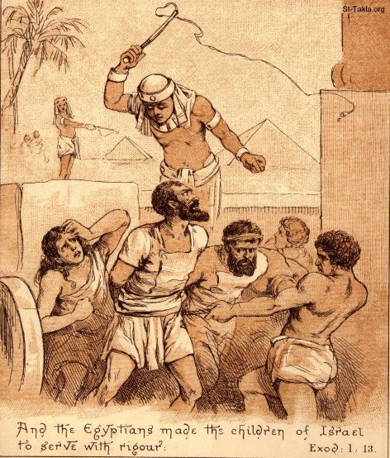
Conditions of slavery
1. The conditions of slavery have varied widely around the world. In some places, slavery was temporary.
- Roman slaves ordinarily had the right to buy themselves out of slavery
2. Slavery was not necessarily inheritable. Slaves of rich people were adopted by the family.
3. Slaves were not necessarily powerless and poor

Slide 9
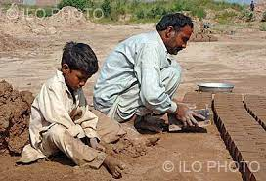

Indentured servitude (bonded labor)
Indentured servitude is a form of labor in which a person is contracted to work without salary for a specific number of years. May be entered "voluntarily" for supposed compensation or debt repay men
Bonded labor is designed to exploit workers.
It is most common in India, Pakistan, Bangladesh and Nepal. In fact, the majority of the world’s slaves live and work in India in a form of bonded labor.

Slide 10
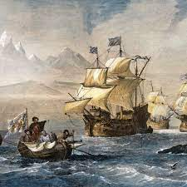
Slavery in new world
1. Because slavery has a broad range of causes, some analysts conclude that racism didn’t lead to slavery but, rather, that slavery led to racism.
2. People who wanted to start a new life in the American colonies but could not pay for their passage across the ocean would arrange for a ship captain to transport them on credit.
3.With time, colonists then turned to Africans, who were being brought to North and South America by the Dutch, English, Portuguese, and Spanish.

Slide 11
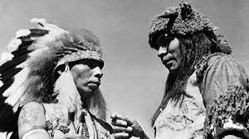
Slavery in new world
To defend slavery, U.S. slave owners developed an ideology, beliefs that justify social arrangements, making those arrangements seem necessary and fair. They developed the view that their slaves were inferior. Some even said that they were not fully human. In short, the colonists wove elaborate justifications for slavery, built on the presumed superiority of their own group.
To make slavery even more profitable, slave states passed laws that made slavery inheritable; that is, the babies born to slaves became the property of the slave owners .
Black people weren’t allowed to sit on the same car.

Slide 12
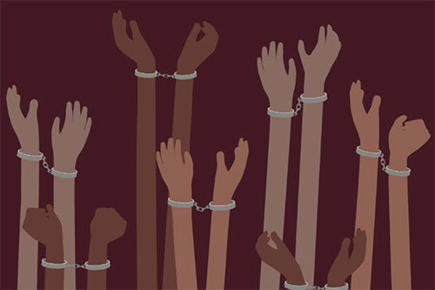
Slavery in Modern world
Globally comprises of two elements: Forced Labor and Forced
Marriages Example: Child Sex Trafficking, Human Trafficking
Notes:
https://cdn.walkfree.org/content/uploads/2022/09/12142341/GEMS-2022_Report_EN_V8.pdf

Slide 13
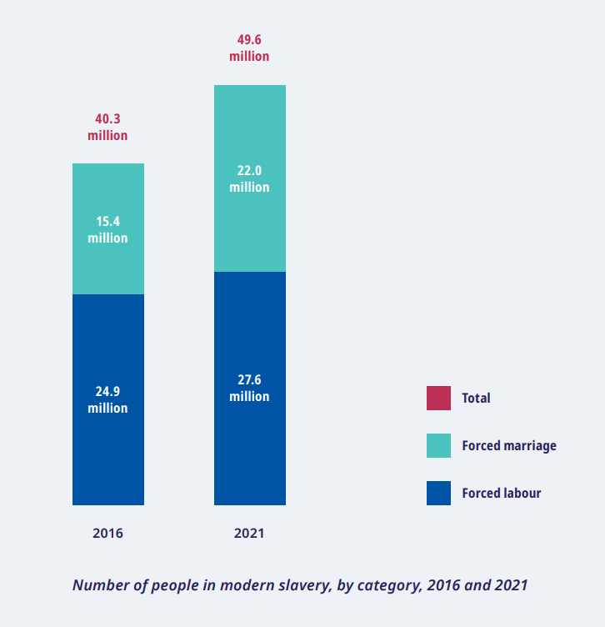

Slide 14
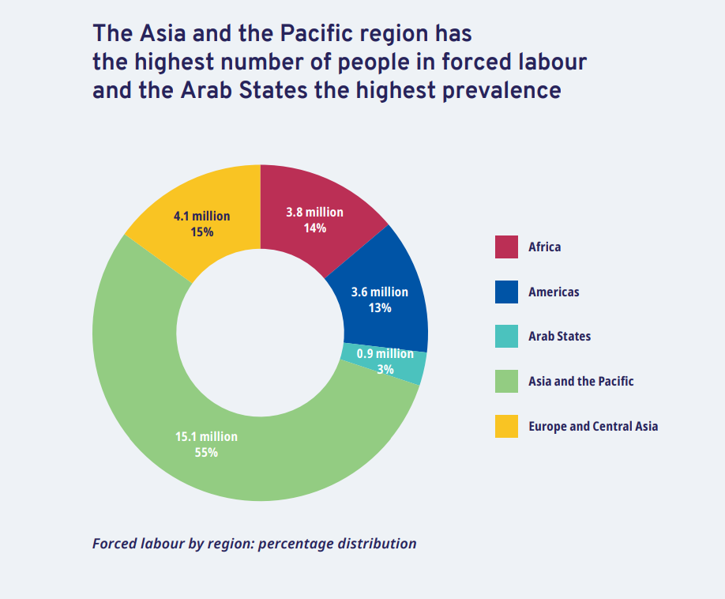

Slide 15
(Hand outs) slavery in Pakistan
1. Bonded Labour – Victims: Poor, landless families; women in debt bondage; poor and illiterate women and children.
2. Child labour and trafficking: Victims Widespread, women; young women and adolescent girls.
3. Forced marriage :Victims of domestic violence; families in debt bondage; Poor families; runaways; victims of forced marriages.
4. Human trafficking: Men and women going for overseas employment. Poor and illiterate women and children from large families
5. Commercial sexual exploitation: Victims of domestic violence; women in forced marriages; victims of fake marriages; transwomen. Street children, nomadic and LGBTQI+ boys.

Slide 16
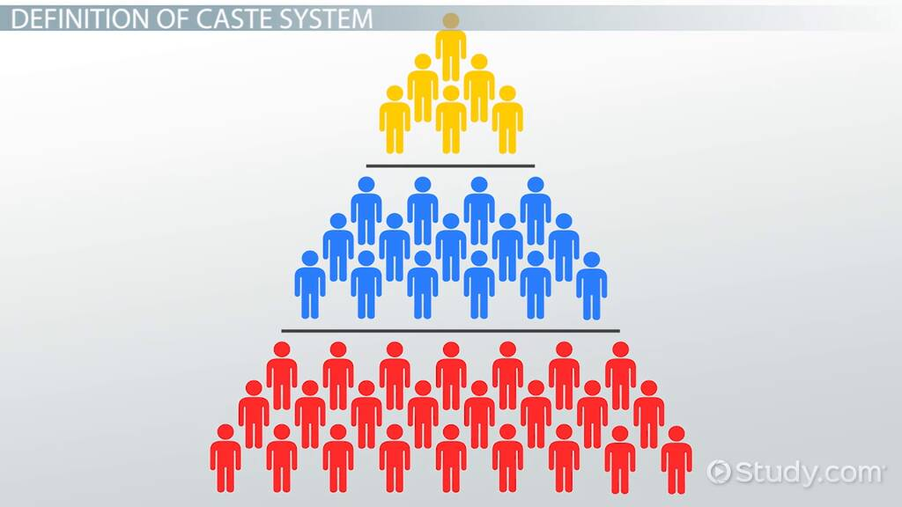
2. Caste
The second system of social stratification is caste. In a caste system, birth determines status, which is lifelong.
Endogamy: They practice endogamy, marriage within their own group, prohibiting the marriage of members of different castes.
India provides the best example of a caste system.
The Indian government formally abolished the caste system in 1949. However, these centuries-old practices continue, and the caste system remains part of everyday life in India.
Slowly, the caste system is giving way, being replaced by a social class system based on material wealth .

Slide 17
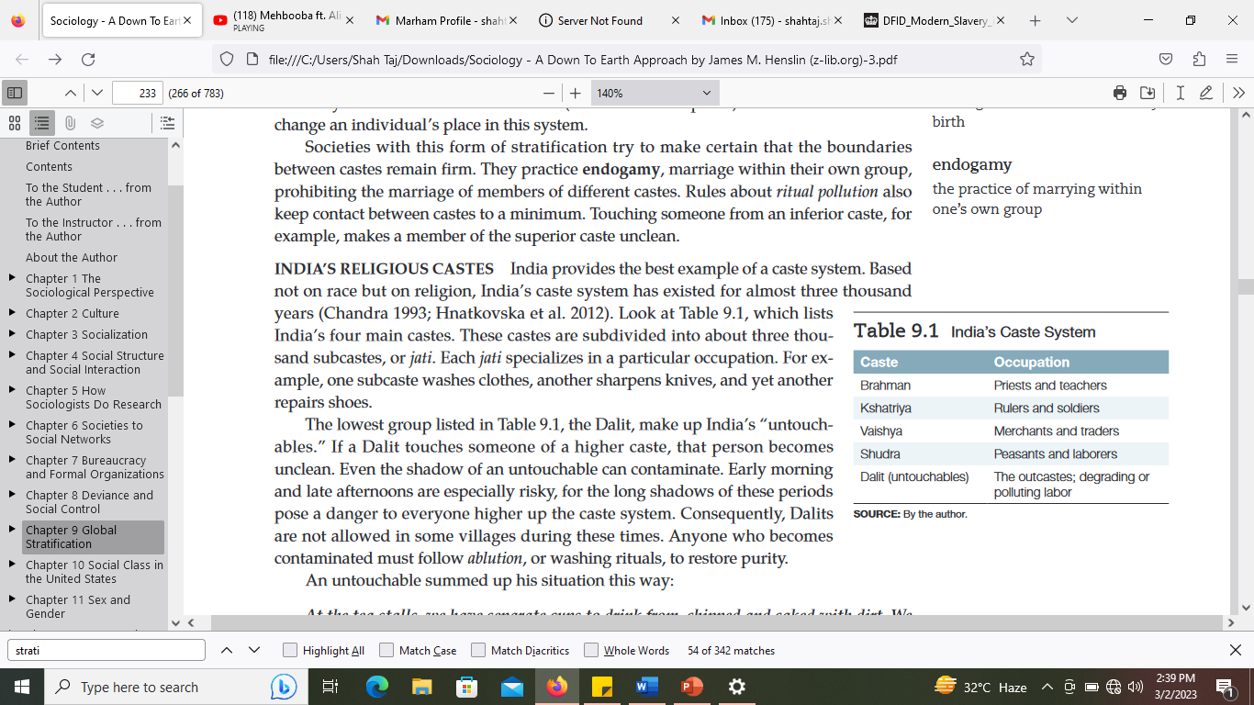

Slide 18
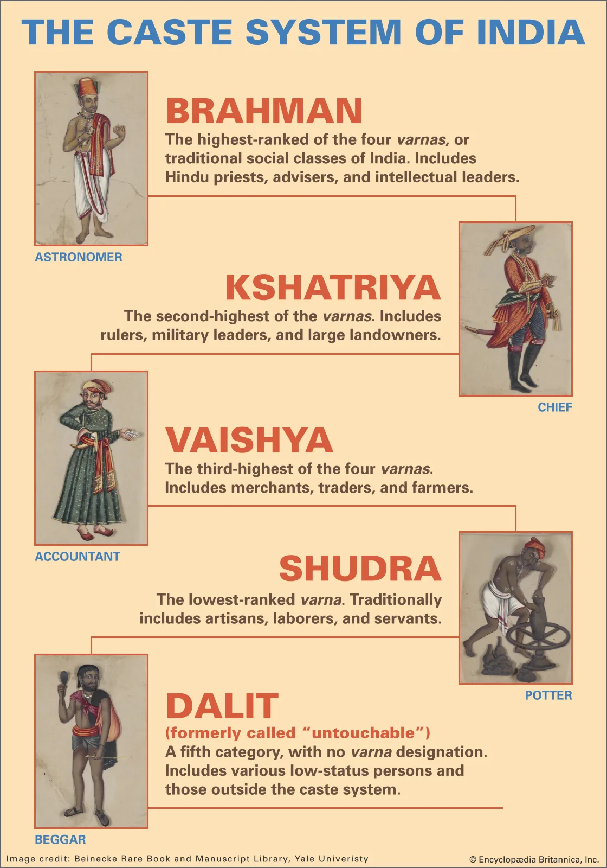

Slide 19

Caste system in Africa
Apartheid: The government-approved-and-enforced separation of racial–ethnic groups as was practiced in South Africa. “the separation of the races.”
Everyone was classified by law into one of four groups: Europeans (whites) Africans (blacks), Coloureds (mixed races), and Asians. These classifications determined where people could live, work, and go to school.
In 1994, Nelson Mandela, a black, was elected president. Black Africans no longer have to carry special passes, public facilities are integrated, and all racial–ethnic groups have the right to vote and to hold office
Even though the U.S. murder rate is so high it intimidates foreigners, South Africa’s murder rate is six times higher.

Slide 20

3. Estate
During the middle ages, Europe developed an estate stratification system.
1. Nobility
2. clergy
3. commoners
Notes:
https://greyhistory.com/french-revolution-articles/explained_the_three_estates_of_the_french_revolution/#:~:text=Summary%20of%20the%20Three%20Estates&text=The%20First%20Estate%20consisted%20of,french%20society%20(the%20commoners).

Slide 21
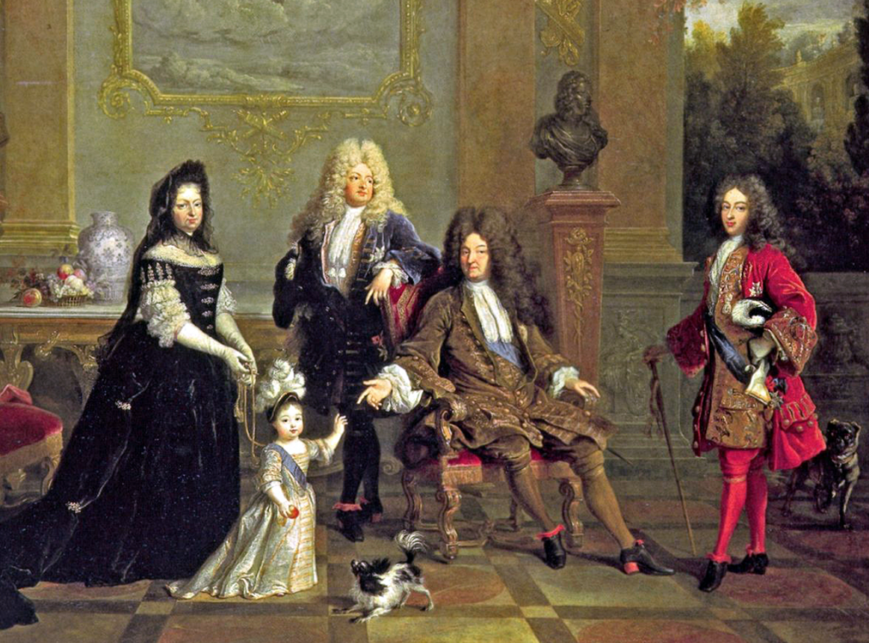
1 nobility
The first estate was made up of the nobility, the wealthy families who ruled the country. This group owned the land, which was the source of wealth at that time. The nobility did no farming themselves, or any “work,” for that matter.
Work was considered beneath their dignity, something to be done by servants. The nobility’s responsibility was to administer their lands, to defend the king (and, in doing so, their own position).
Additionally, aristocrats enjoyed exclusive access to many government, religious, and military positions.

Slide 22
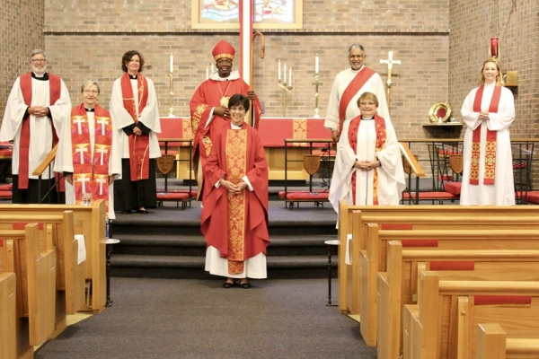
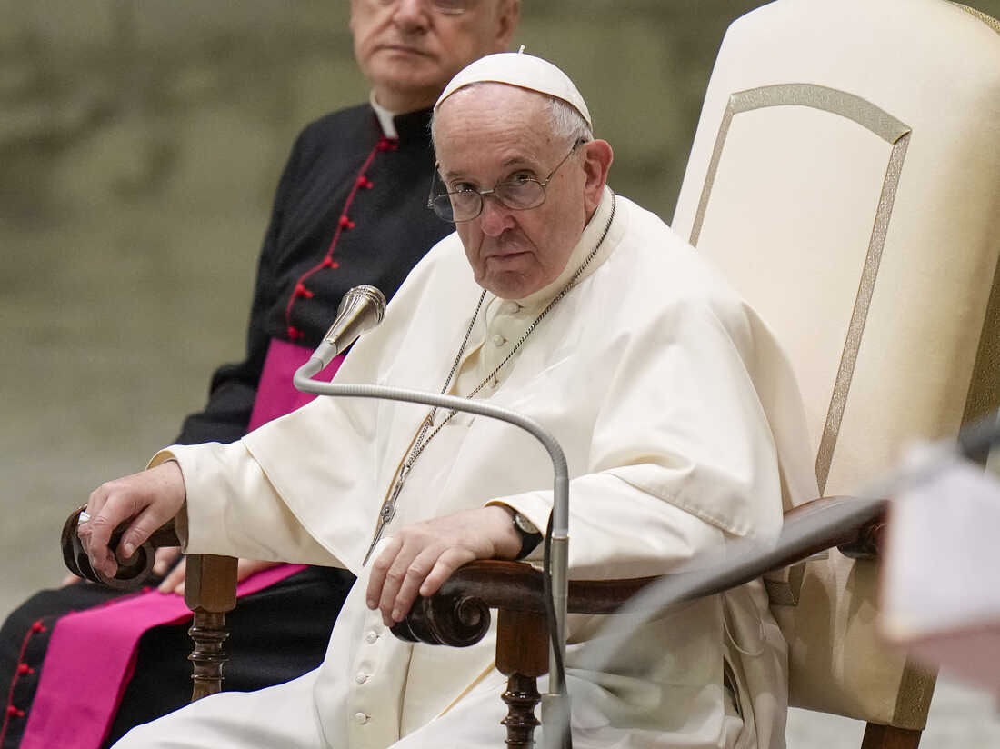
2.clergy
The second estate consisted of the clergy.
The Roman Catholic Church was a political power at this time.
It also owned vast amounts of land and collected taxes from everyone who lived within the boundaries of a parish.
The church’s power was so great that in order to be crowned, kings had to obtain the pope’s permission.

Slide 23
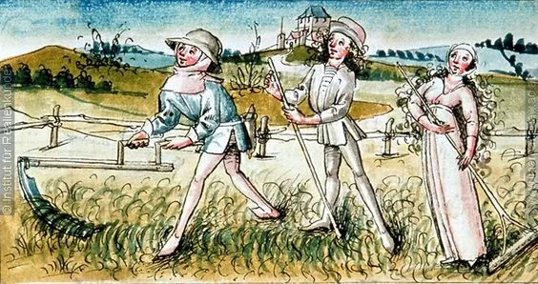
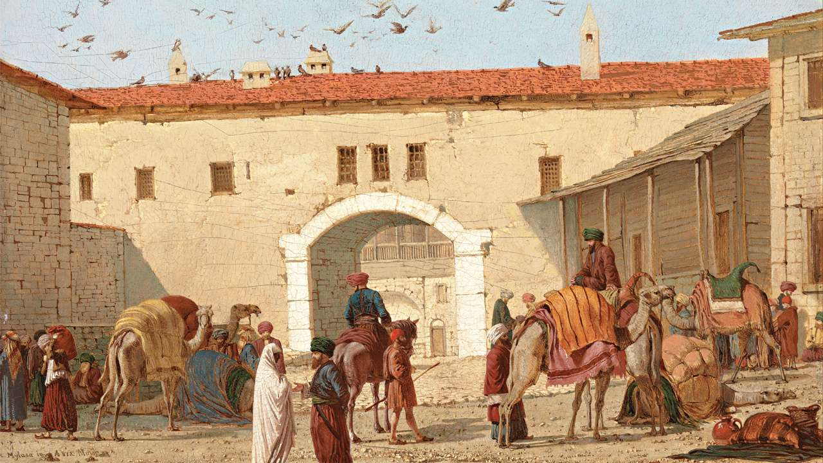
3. commoners
Third Estate was composed of all commoners and was highly non-homogeneous in nature. This estate included wealthy merchants, educated bourgeoisie, skilled artisans, and illiterate.
The rare person who made it out of the third estate was either a man who was knighted for extraordinary bravery in battle or someone“called” into a religious vocation.

Slide 24
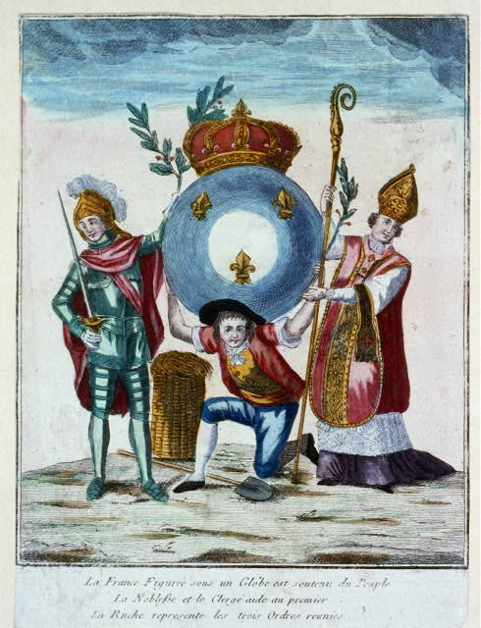

Slide 25
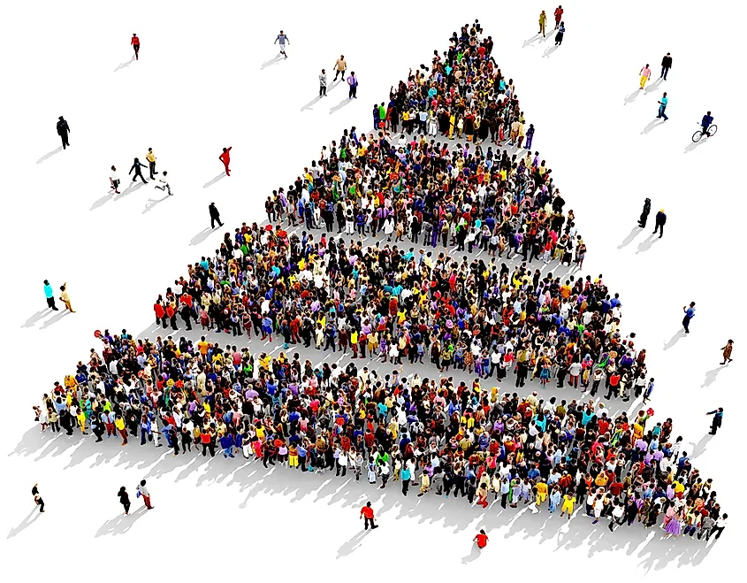
4.Class
A class system, in contrast, is much more open, because it is based primarily on money or material possessions, which can be acquired.
It’s a form of social stratification based primarily on income, education, and prestige of occupation
Class system allows social mobility, movement up or down the class ladder.

Slide 26


social
Notes:
Page:276

Slide 27

SOCIAL MOBILITY
Social mobility movement up or down the social class ladder.
It refers to how a person’s social standing changes with time.
Notes:
https://www.slideshare.net/NagamaniManjunath/social-mobilitypptx

Slide 28
TYPES OF SOCIAL MOBILITY
Intergenerational mobility: the change that family members make in social class from one generation to the next
Upward social mobility: movement up the social class ladder
Downward social mobility: movement down the social class ladder
Structural mobility :movement up or down the social class ladder that is due more to
changes in the structure of society than to the actions of individuals

Slide 29
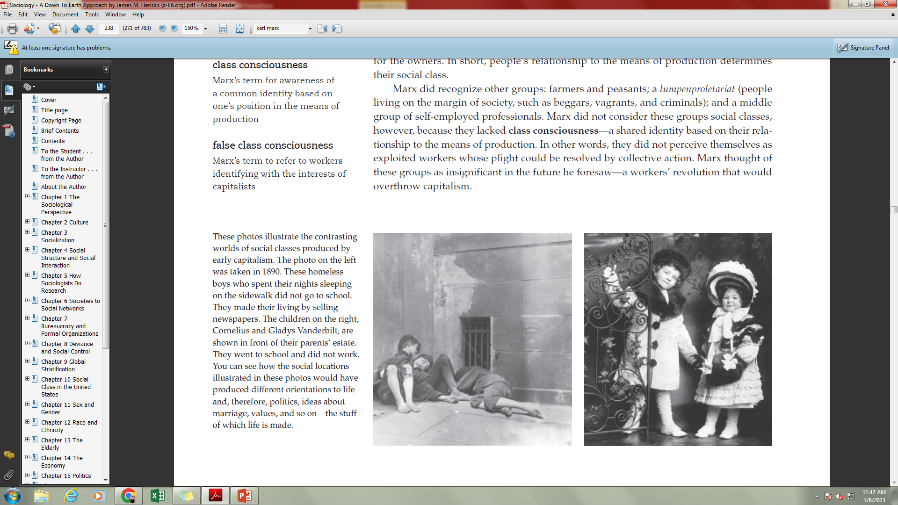
THEORATICAL PERSEPCTIVES on social stratification
Karl Marx argued that a single factor determines social class: If you own the means of production, you belong to the bourgeoisie; if you do not, you are one of the proletariat.

Slide 30
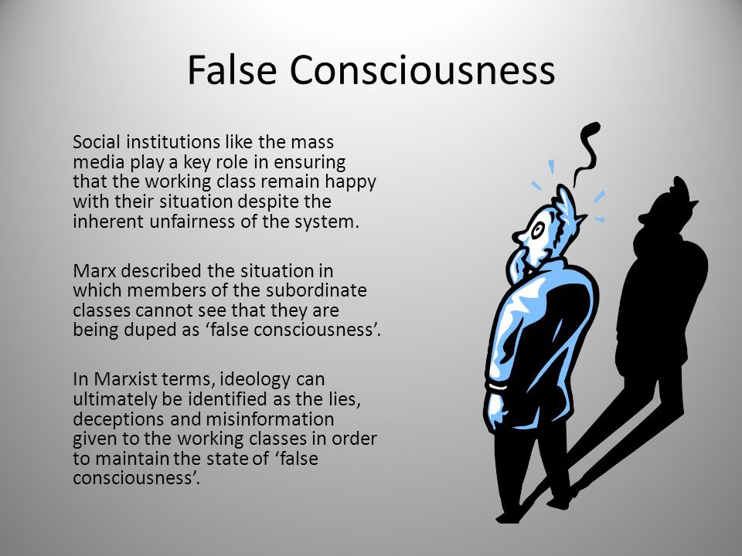
False class consciousness
Workers mistakenly thinking of themselves as capitalists. For example, workers with a few dollars in the bank may forget that they are workers and instead see themselves as investors, or as capitalists who are about to launch a successful business.
Notes:
243

Slide 31
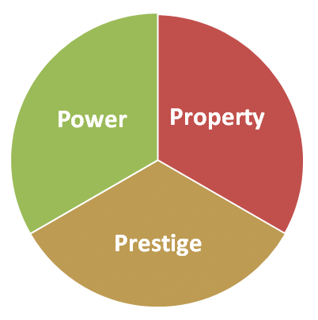
Max Weber: Property, Power, and Prestige
Weber argued that property is only part of the picture. Social class, he said, has three components: property, power, and prestige.
1. Property (or wealth), said Weber, is certainly significant in determining a person’s
standing in society.
2. Power, the second element of social class, is the ability to control others, even over
their objections.
3. Prestige, the third element in Weber’s analysis, is often derived from property and
power, since people tend to admire the wealthy and powerful

Slide 32
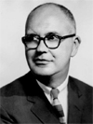

Why inequality is universal?
Wilbert Moore (1945, 1953), wrestled with this question. They concluded that stratification of society is inevitable because:
1. For society to function, its positions must be filled.
2. Some positions are more important than others.
3. The more important positions must be filled by the more qualified people.
4. To motivate the more qualified people to fill these positions, they must offer greater
rewards.

Slide 33
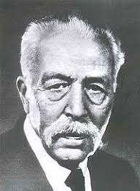
The Conflict Perspective:
Class Conflict and Scarce Resources:
Mosca’s Argument Italian sociologist Gaetano Mosca argued that every society will be stratified by power. This is inevitable, he said in an 1896 book titled The Ruling Class, because:
1. No society can exist unless it is organized. This requires leadership to coordinate
people’s actions.
2. Leadership requires inequalities of power. By definition, some people lead, while others follow.
3. Because human nature is self-centered, people in power will use their positions to bseize greater rewards for themselves

Slide 34
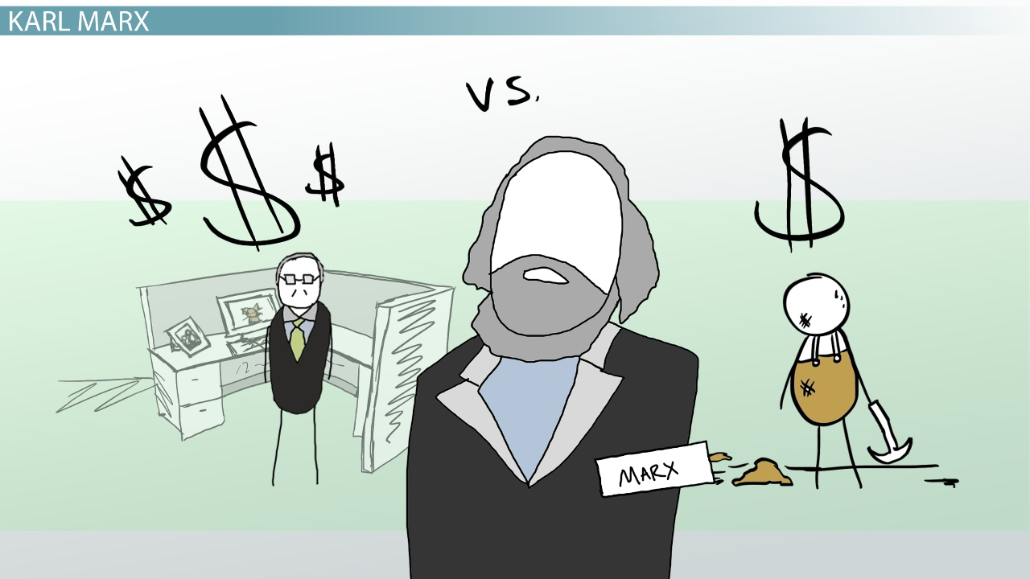
Current Applications of Conflict Theory
They examine how groups within the same class compete with one another for a larger slice of the pie (Collins 1999; King et al.2010).
Even within the same industry, for example, union will fight against union for higher salaries, shorter hours, and more power. Another focus of conflict theorists is conflict between racial–ethnic groups as they compete for education, housing, and evenprestige—whatever rewards society has to offer.
They also study the relations between women and men, which conflict theorists say are best understood as a conflict over power—over who controls society’s resource

Slide 35

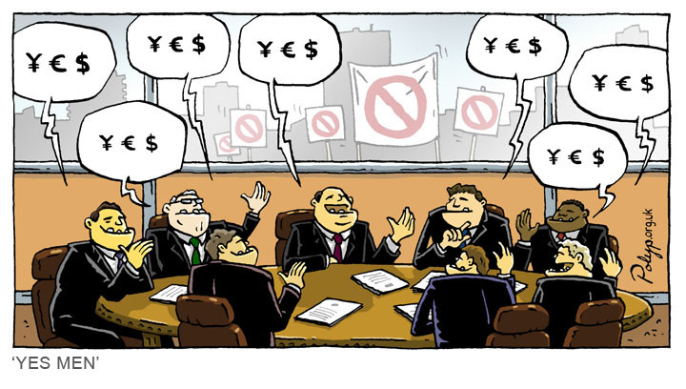
How elite maintain power?

Slide 36
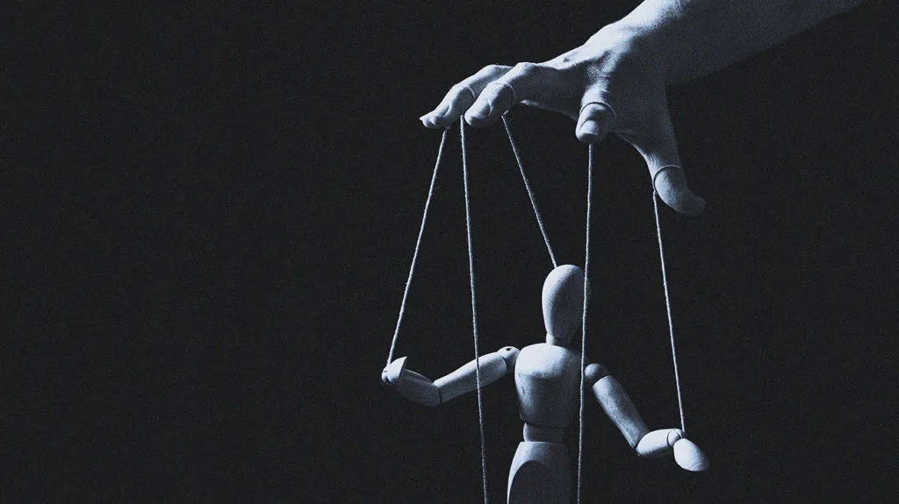
How Do Elites Maintain Stratification?
Controlling People’s Ideas
Controlling Information
Stifling Criticism
Big Brother Technology

Slide 37

Strains in the Global System
Contradictions Threaten Failure or Collapse
Historical shifts bring cataclysmic disruptions
We are now living through such a time

Slide 38

THANK YOOU1!!!

